Slide 1
Lesson Four
Food preparation, cooking and service

Slide 2

Discuss
How do you defrost food at home?
What other methods of defrosting are there?
Which method is the safest? And why?
What are the dangers of not properly and thoroughly defrosting food?
Notes:
How do you defrost food at home?
There are three main ways to defrost food:
Defrosting in the cooking process
Defrosting in the refrigerator
Defrosting in a microwave
Which method is the safest? And why?
Defrosting in the refrigerator is the safest method of defrosting food as it keeps food out of the ‘Danger Zone’.
Most food bacteria multiply in the temperature range of 5°C to 63°C (known as the ‘Danger Zone’) . When food has been cooked and re-enters the danger zone as it cools, spores can revert back to their normal state when they can multiply in the right conditions.
Food left in warm kitchens (where the temperature is in the ‘Danger Zone’) will allow bacteria to grow and multiply much more quickly than food stored under refrigerated conditions.
What are the dangers of not properly and thoroughly defrosting food?
The risk of bacterial growth during thawing and producing higher numbers of bacteria in the food
Incorrect practices like defrosting under a running tap, transfers bacteria around the kitchen by drops and splashes and leads to cross-contamination.

Slide 3
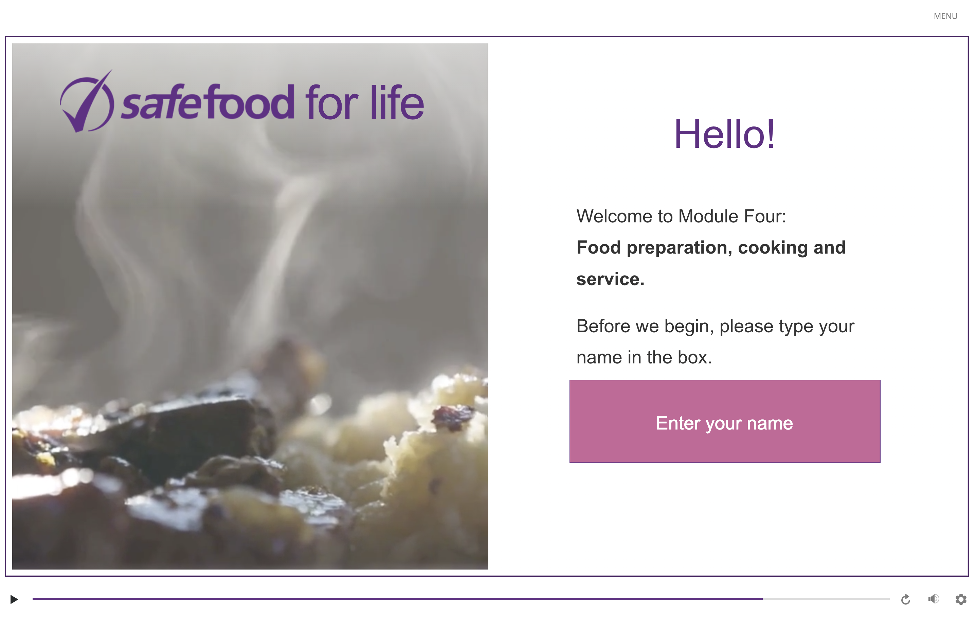
eLearning module

Slide 4
In class task
List examples of when food may be left in the danger zone for too long. For example, putting frozen meat in a slow cooker on a low temperature will mean the food stays in the danger zone for longer than needed.
Consider ways of preventing this. For example, defrosting meat before putting in a slow cooker.

Slide 5
Homework task
Create a Freezer Diary using the food in your freezer at home and the example provided on the next slide. Your freezer diary needs to have the following information about the food:
Today’s date
Food item
Weight of the food
Portion size
Use by date
Approximate time it will take for the food to defrost
Where the food is in the freezer

Slide 6
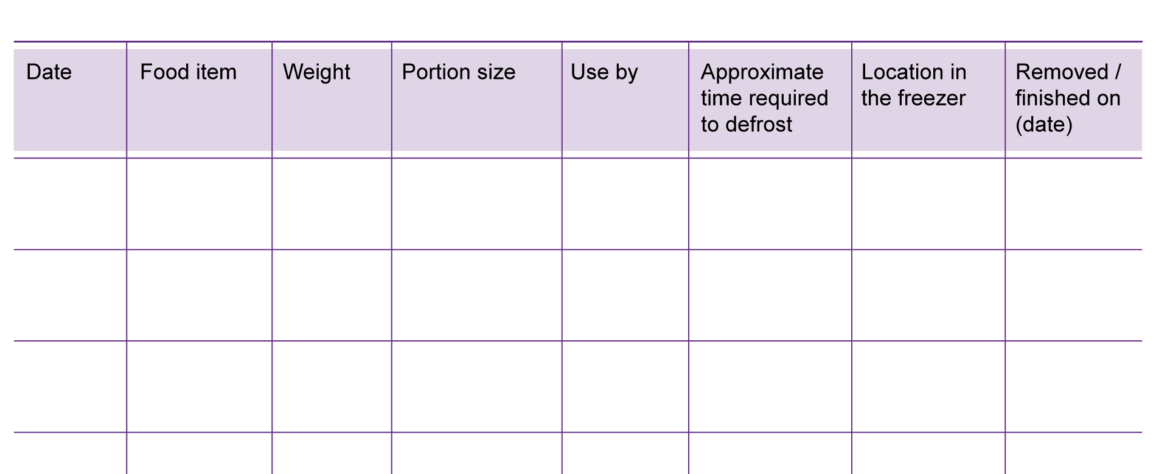
Sample freezer diary

